Slide 1
Agenda
Marketing Plan Overview
Facebook page info and admins
Content calendar and August content
Scheduling posts examples
Canva
Brainstorm
Facebook Tips
Notes:
My name is Kadra Clark and I am the business marketing intern for Orbis! I am currently a college student studying business marketing. I created the Land of Goshen Ministries Facebook page for you all and scheduled content for August!

Slide 2
Land of Goshen Ministries
Facebook Page

Slide 3
Overview of Marketing Plan
Goals:
Increase awareness of the non-profit to the community and donors
Create a memorable brand that other entities in the community can follow and support
Gain a better understanding of the increasing needs of clients served
Understand the perception community members have of the non-profit
Notes:
The goal with using a Facebook is to increase awareness in the community of who you are and what you guys do. We want to get more community members involved whether that means donations of items or money. Getting feedback from the community is important and can help in the long run.

Slide 4
Audience
Consumers/People served through the food pantry
Shoppers at the thrift store
Donors
To serve more community members, the organization needs to promote the thrift store and food pantry through multiple methods and expand its donor base.
Notes:
The audience that we are looking to attract via the Facebook page is consumers served through the food pantry, shoppers at the thrift store, and potential donors. Having a facebook page and posting consistently can help expand your donor base. It helps to see the people behind the operation as well as highlighting items.

Slide 5
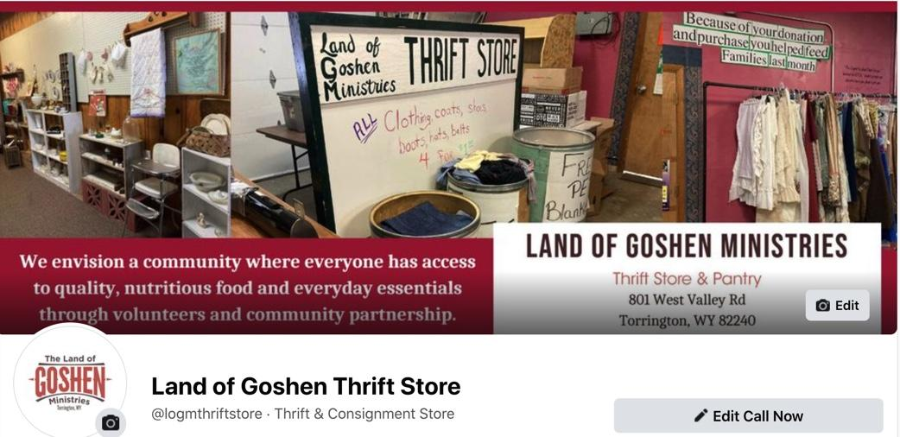
Username: @logmthriftstore
No password, just need to add admins and editors
Notes:
I created the Facebook page with the username @logmthriftstore and added a profile picture, cover photo, and all of the about information for people to see. There is no password, I can add whoever would like to be admins or editors by inviting you off of your personal page. When you go to the Land of Goshen Thrift Store page, however, it will show you are interacting as them.

Slide 6
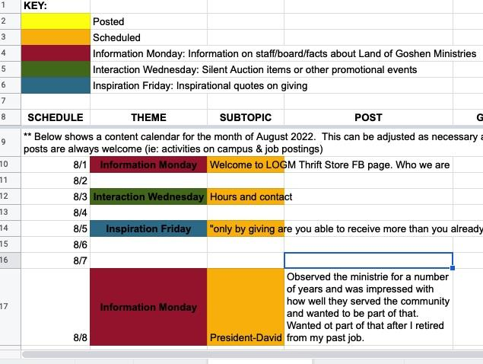
Content Ideas and Scheduling
Example of how to plan and keep track of scheduling content
Notes:
This is a small example of how to plan and keep track of scheduling content. A color-coded key is the best way I have found to show myself what needs created and what is already scheduled. This is where I have a monthly spreadsheet with the dates, the theme, the topic, and sometimes I even put the content that I am posting.

Slide 7
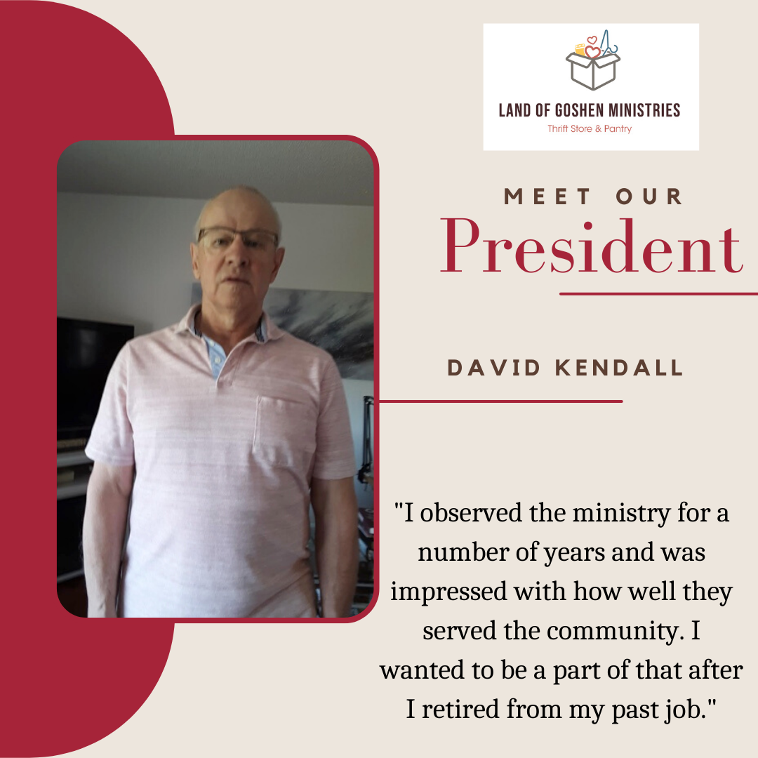
Monday’s: Information about LOGM/Staff
Meet the Staff: We have scheduled David and Judy (every other week).
You can continue on with this graphic and your other members/volunteers.
The weeks in between: information about LOGM-history, facts, who you are
Notes:
During this month, I scheduled two Monday’s with Meet the Staff (Judy and David) every other week. The other two weeks I have done information about the LOGM-history, facts, who you are. This can be continued on by a board member gathering a photo and a quote by a board member to keep showing the people behind this operation!

Slide 8
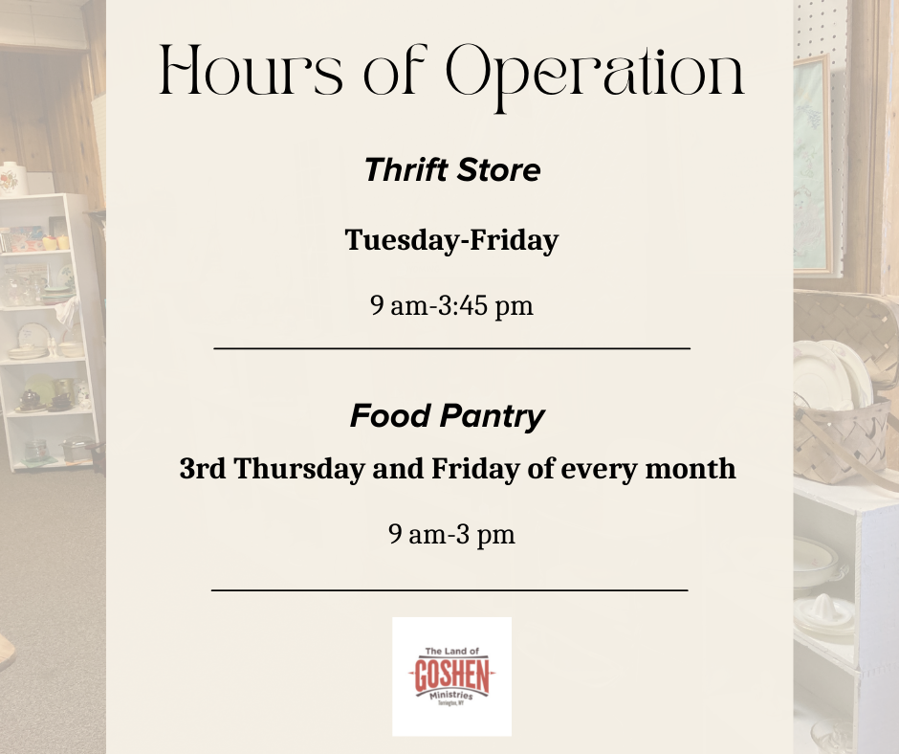
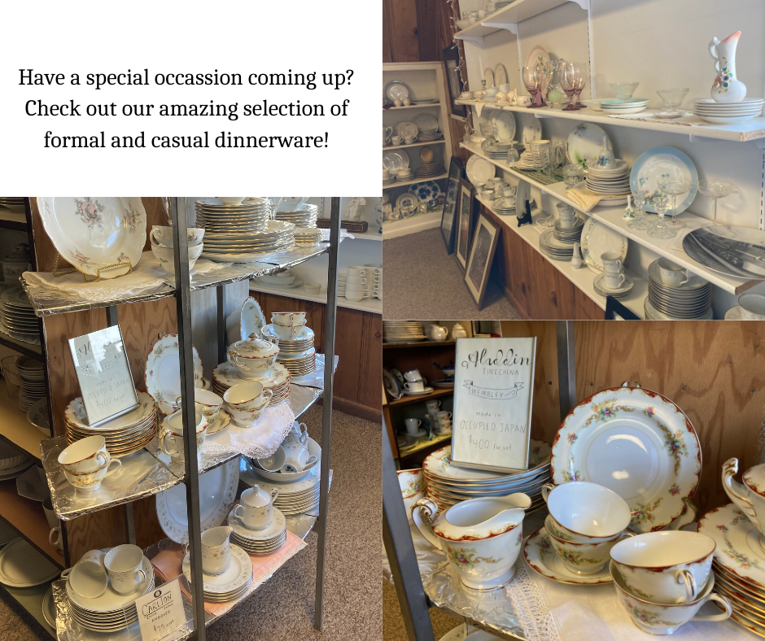
Wednesday’s: Highlight items/donate
Notes:
Take pictures of items or deals you have running and sell them on facebook! Try to get people to come see what you have to offer.
Hours of operation is something you can continually post. Talk about the Food Pantry!

Slide 9
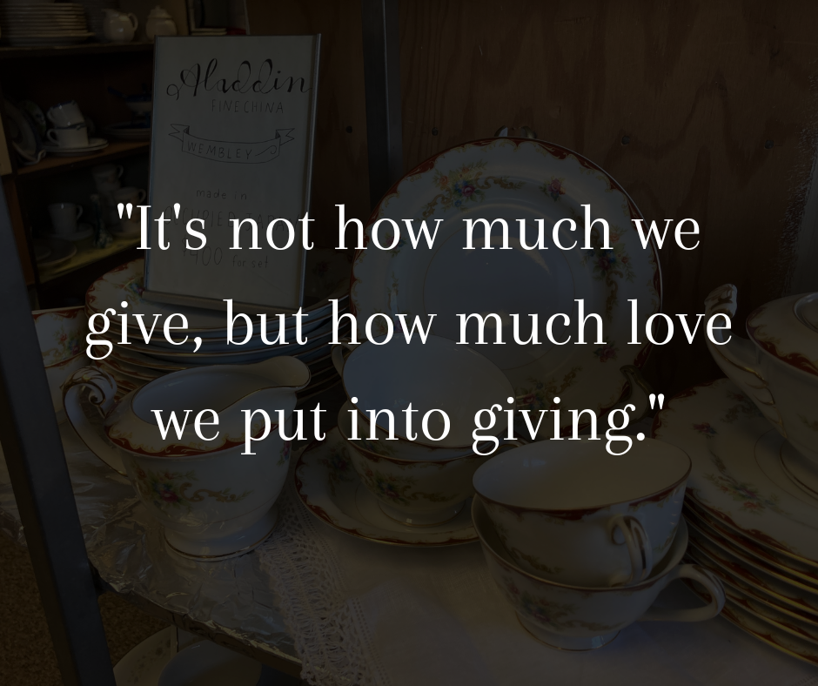
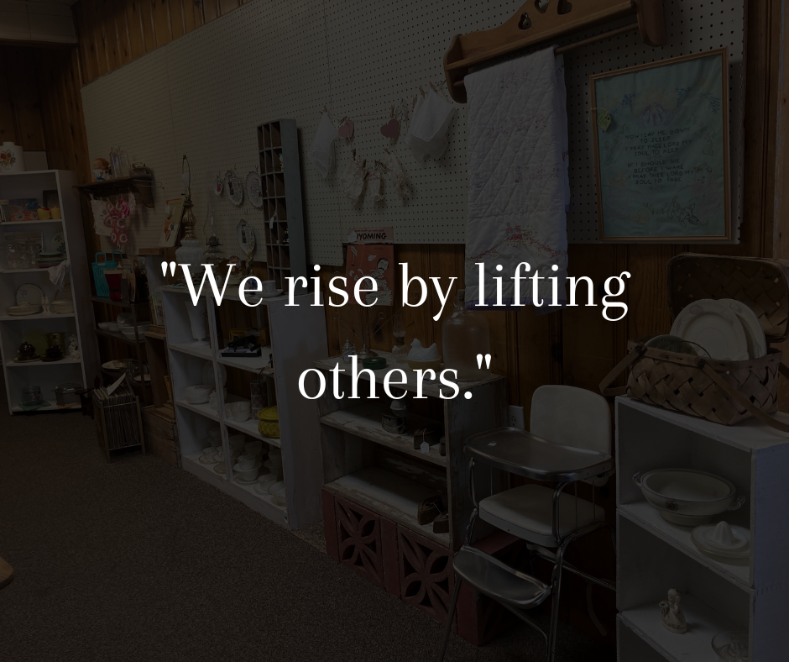
Friday’s-Quotes about giving/inspiration
Notes:
Take a picture of stuff in the store, add it into the canva graphic and search google for an inspirational quote or something about giving!

Slide 10
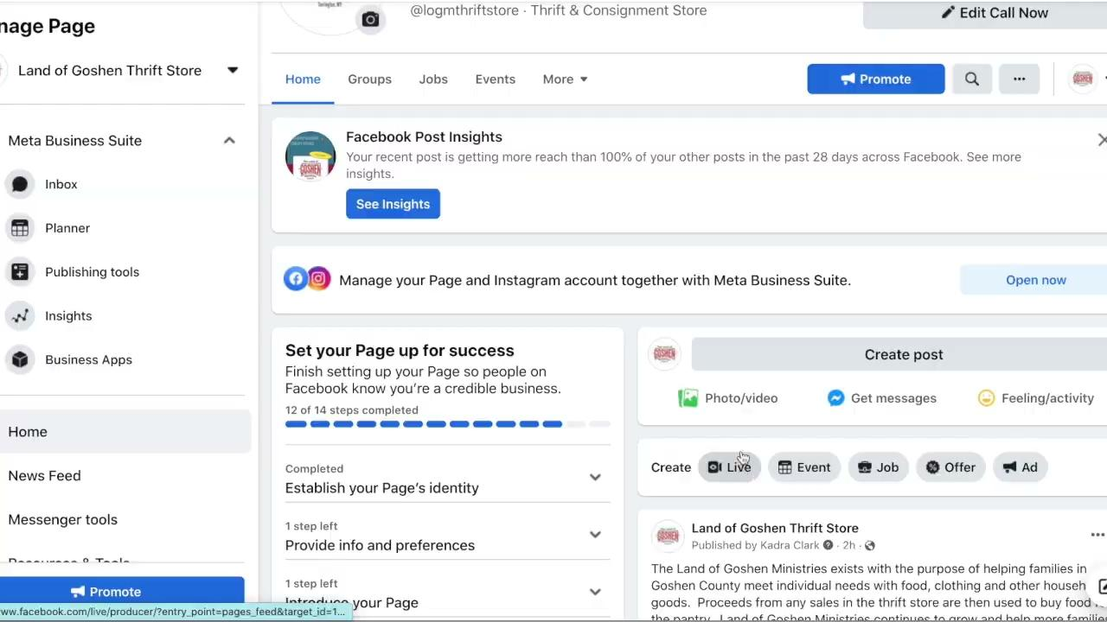
Posting to Facebook-right away (not scheduling)
Notes:
This is if you want to post something right at that minute, instead of scheduling it for a later date and time.

Slide 11
Using MetaBusiness Suite to schedule posts
Go to LOGM Thrift Store Facebook
Go to MetaBusiness Suite
Planner
Click day you want to schedule
Choose time to post
Add photo
Add text
Schedule post
Notes:
This video is if you want to use the MetaBusiness Suite to schedule your posts ahead of time.

Slide 12
Canva
Create your own personal free account-mobile or desktop vers
Access graphics we have already created for you and use as a base for new content
Create and save content to post to Facebook!
Notes:
Canva is the site that I use to create all of my content graphics. You can create a free account and access from the internet or there is a mobile app you can download.

Slide 13
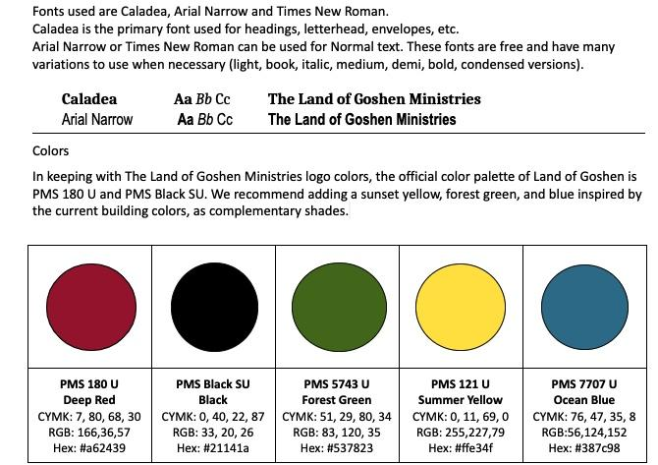
When creating graphics, we want to consistently use the color palette!
It is okay to get creative with your fonts, but incorporate the LOGM fonts as well!
Notes:
This shows the fonts and the colors chosen in your marketing plan that really represent Land of Goshen Ministries. When I create graphics, I try to stay consistent to my color palette. When I use fonts, I like to get creative at times but also incorporate the specific fonts for LOGM. In Canva, when you need to choose a color, you can add a color and typing in the HEX # example a62439 creates the color deep red from your color palette. I also like to add in logos or your brand graphics to give it brand personality.

Slide 14
Basic Graphic Design
https://www.canva.com/
Notes:
I am going to take you into Canva, where you can set up a free account and show you how to navigate through and create a basic graphic design.

Slide 15
Brainstorm
Let’s talk about ideas and content to post together!
Notes:
Now that I have shown you what I have scheduled already, let’s talk about some ideas for you guys to continue creating. The goal is to post 3 times a week-a good way to go about this potentially would be to have one person on Monday content, one on Wednesday, and one on Friday. That way the workload can be divided up. I have already started the posts on Monday every other week with “Meet the Staff”. I already did Judy and David-if someone would like to continue that and get a picture and a quote from more board members.

Slide 16
Facebook Tips
Make sure your posts have images attached; having an image generates 94% more views
Best time to post: 6-8 am or 2-5 pm
Length: 100-150 characters
Call to action: encourage to share, comment, or like
Consistency is important, so try to regularly post around the same time 3 times a week
Ask questions, encourage people to comment
Notes:
Here are some tips for facebook to help optimize views and gaining a bigger audience. My best tip is to always attach an image with your posts, because people are more likely to stop their scroll and read it if there is an image attached. The best time to post is either early morning before people go to work or late afternoon/evening when people get off of work. This is when people are most likely to look at facebook. It is important to not make your text too long. Your audience will only stay interested if they can read it quickly and it does not take forever. Another tip is to encourage people to share, comment, or like. You can do this by asking questions at the end of your text (How can you help your community?)

